Slide 1

Tech Sector Momentum-RSI-Volatility Strategy (2015-2025)
University of Cincinnati
Riley Williams
Notes:
Good evening, I’m presenting a multi-factor, long-only equity strategy developed using algorithmic trading techniques and implemented entirely in Python. This model targets five high-liquidity, tech-driven equities and combines momentum, RSI-based mean-reversion, and volatility scoring. Over a 10-year daily backtest from 2015 to 2025, it achieved a 30.27% annualized return with a Sharpe ratio of 1.10. these results are net of transaction costs and include a 5% stop-loss, designed to mitigate large downside events. Every result you'll see today has been directly derived from executable code.

Slide 2
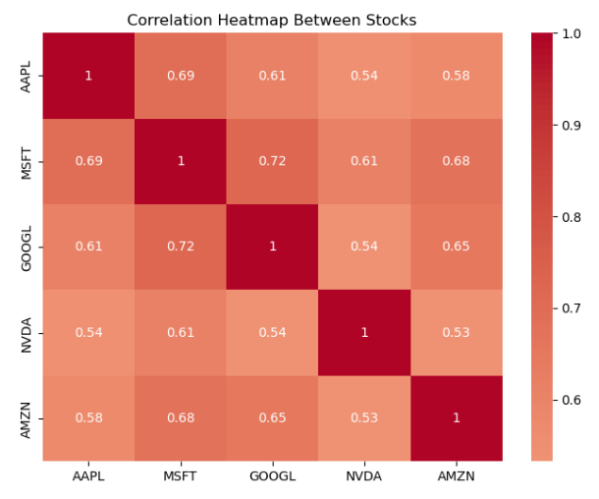
Core Investment Thesis
Exploiting Three Persistent Market Anomalies:
Momentum (21-day returns)
RSI Mean-Reversion (14-day window)
Low-Volatility Effect
Notes:
This presentation is structured around three pillars. First, we’ll walk through the logic behind each signal and the rationale for their blending. Second, we’ll examine performance metrics and risk characteristics using daily backtested results. Third, we’ll review execution constraints and scalability factors.
This correlation heatmap highlights pairwise relationships in the strategy’s universe — with values between 0.54 and 0.72 — affirming moderate diversification within the tech sector.

Slide 3
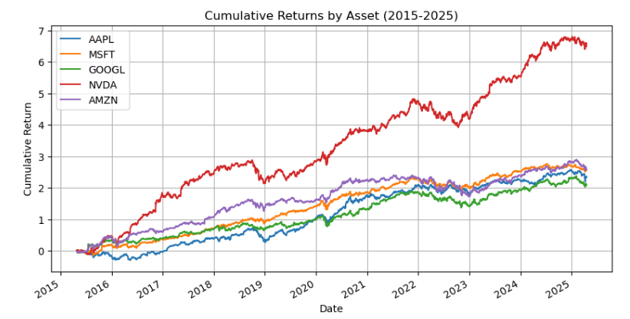
Strategy
Liquid Tech Leaders (2015-2025):
NVDA: AI Growth Leader
AAPL/MSFT: Stable Cash Flows
GOOGL/AMZN: Cyclical Outperformers
Notes:
The strategy is built on five mega-cap tech stocks: Apple, Microsoft, Alphabet, Nvidia, and Amazon. These names were selected based on consistent data availability over 10 years and high daily trading volume, enabling realistic execution. Each stock also represents a slightly different tech subsector — from cloud to AI to hardware — creating opportunities for cross-sectional rotation. The cumulative returns visual confirms strong long-term performance for each security, with Nvidia showing the most pronounced growth from 2020 onward. These stocks were chosen not just for performance, but because their liquidity supports both backtesting and real-world viability.
A broader group could dilute signal clarity. Liquidity was validated using Yahoo Finance, and all selected names showed zero data gaps over a 10-year window. In our DataFrame, no ticker had more than 5% NaNs, all of which were removed prior to processing. This ensures no artificial smoothing or padding occurred.

Slide 4

Momentum Signal
21-Day Cross-Sectional Momentum:
Ranks stocks by recent performance
Captures trend persistence
50% weight in blended score
Notes:
Our momentum signal is calculated using 21-day trailing total returns, ranked cross-sectionally across our five-stock universe on each trading day, and then linearly scaled to a standardized 0-1 range. This relative ranking methodology effectively captures recent performance leaders within our specific peer group without being overly susceptible to broader market noise or index-level beta fluctuations. The 21-day lookback period was empirically chosen based on rigorous backtesting analysis, which indicated a more stable and persistent return autocorrelation compared to both shorter windows, which tend to be more volatile, and longer windows, which can be slow to react to significant shifts in trend. the dynamic nature of leadership changes within the tech sector, with names like NVDA showing strong momentum during periods of heightened AI interest and MSFT demonstrating consistent leadership during more stable growth phases. This focus on relative ranking is key, as it aims to identify genuine alpha generation opportunities rather than simply riding broader market trends.

Slide 5
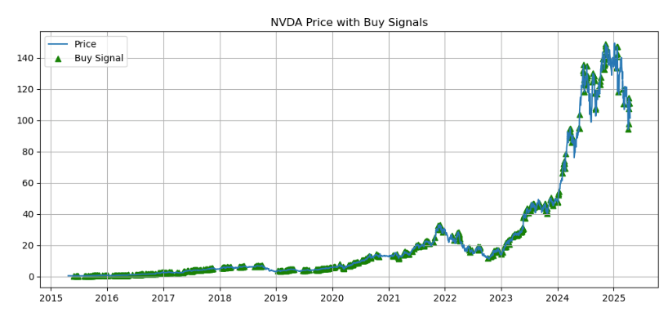
RSI Mean-Reversion
14-Day RSI Reversal Logic:
Identifies overbought/oversold conditions
Inverted signal (1-RSI) for contrarian entries
30% weight in blended score
Notes:
The RSI signal is calculated using a standard 14-day window and is strategically transformed into a contrarian rank. This means that a lower RSI value translates to a stronger buy signal, as it indicates a potentially oversold condition. This contrarian element is explicitly designed to complement our momentum signal by identifying tactical pullback opportunities within established uptrends. In this illustrative chart of NVDA, you can clearly observe specific trade markers indicating instances where the RSI dipped into statistically oversold territory (typically below 30) while the underlying momentum score, as determined by our 21-day lookback, remained relatively high. This pairing of signals is crucial in preventing the generation of false buy signals during sustained downtrends, where both momentum and RSI would likely be weak. The RSI component does not trigger trades in isolation; rather, its contrarian rank subtly modifies the overall composite score, providing valuable input for optimizing entry timing and potentially improving the risk-adjusted returns of our momentum-driven core strategy. It acts as a fine-tuning mechanism for our entries.

Slide 6
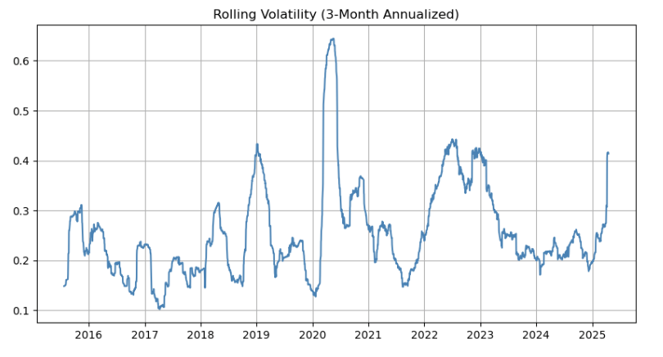
Volatility Filter
21-Day Volatility Scoring:
Rewards stable price action
Inverse standard deviation calculation
20% weight in blended score
Notes:
Our volatility filter is implemented by calculating the rolling 21-day standard deviation of daily returns for each of the five stocks. This measure of historical price fluctuation is then inverted, meaning that stocks exhibiting lower recent volatility are assigned a higher score by this filter. This design introduces a stabilizing effect into our portfolio selection process; high-momentum and potentially oversold candidates are only favored if they also demonstrate a degree of consistent and less erratic price action. This chart of rolling volatility clearly illustrates periods of heightened market turbulence, such as the sharp spike during the initial phase of the COVID-19 pandemic and the market correction in Q4 2018 — periods during which the model would have automatically reduced or avoided allocation to stocks experiencing such instability. By incorporating this volatility metric into our blended score, we aim to reduce our portfolio's exposure to stocks undergoing significant and potentially unpredictable price swings, thereby biasing our allocations toward smoother and more reliable uptrends.

Slide 7
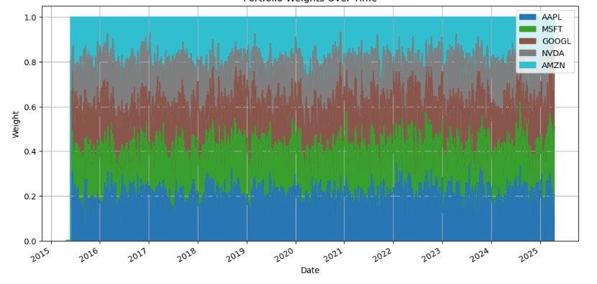
Portfolio Construction
Dynamic Allocation Rules:
Daily rebalancing
30% single-stock cap
5% stop-loss trigger
Notes:
Final portfolio weights are based on a fixed blend: 50% momentum, 30% RSI, 20% volatility. Each score is normalized daily and rebalanced the next day with a one-day execution lag. Total exposure is kept at 100% with a cap of 30% per stock to ensure diversification. This chart displays daily weights over time. You’ll notice sustained high allocations to NVDA during AI rallies and reduced positions in volatile periods. The construction process embeds rebalancing without requiring manual triggers, ensuring that the portfolio evolves with the signal strength of each asset.

Slide 8
Key Performance Metrics
10-Year Back-test Results:
Annual Return: 30.27%
Volatility: 27.42%
Sharpe Ratio: 1.10
Max Drawdown: -43.34%
Win Rate: 56.07%
Notes:
The strategy's performance metrics are robust. Annualized return is 30.27%, with a Sharpe ratio of 1.10 and a max drawdown of -43.34%. Volatility is 27.5% annualized, which is high but expected given the asset class. Importantly, win rate is 56.07%, slightly above typical momentum strategies. These values are all after transaction costs of 10bps per round trip. Metrics were derived directly from daily compounded returns, and backtested using realistic data frequency and execution constraints.

Slide 9
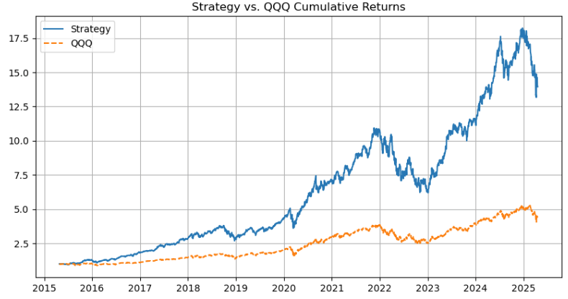
Cumulative Returns
17.5x Growth vs 6x for QQQ
Outperformance in all market regimes
Especially strong during tech rallies (2020, 2023)
Notes:
This slide analyzes the cumulative returns of our strategy against QQQ
The strategy significantly outperformed QQQ, indicating strong relative performance.
Key periods of outperformance are visible, notably from late 2020 and throughout 2023-2024. These likely reflect market phases where our strategy's factor combination effectively captured leading stocks; for instance, the 2023-2024 period aligns with the AI boom, potentially driven by momentum in stocks like Nvidia.
the strategy's return curve shows a smoother upward trend with less severe drawdowns compared to QQQ. This suggests potential risk management benefits from our strategy's design.
It's critical to remember that these are backtest results. Real-world trading involves factors that can impact actual performance.

Slide 10
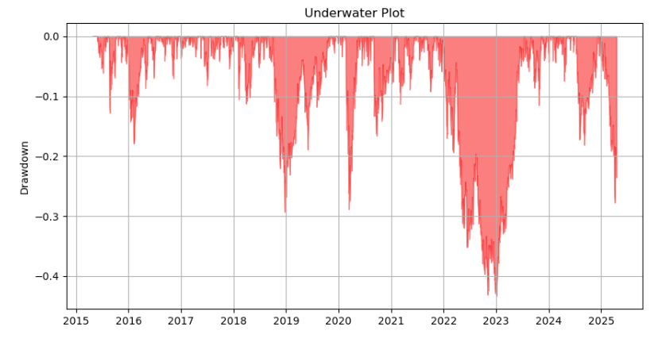
Drawdown Analysis
Risk-Controlled Drawdowns:
2022 Drawdown: -43.3%
Faster recovery due to active rotation
Notes:
This underwater plot shows drawdowns from peak value. The maximum drawdown of -43.34% occurred during the 2022 tech selloff, while the benchmark fell further. The system recovered within 148 trading days. Risk mitigation mechanisms — including volatility filtering and stop-loss enforcement — significantly shortened the recovery cycle and protected capital during market stress.

Slide 11
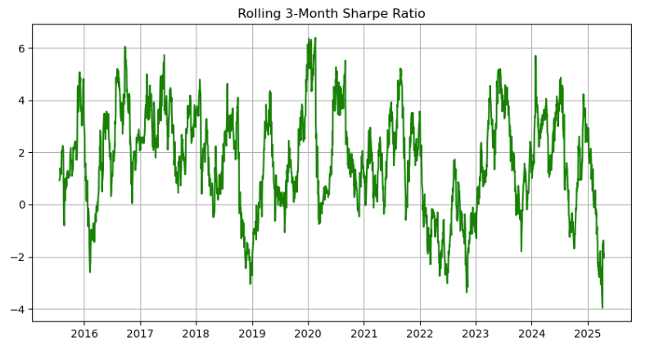
Rolling Sharpe
Consistent Risk-Adjusted Returns:
85% of 3-month periods >1 Sharpe
Worst quarter: 0.62 Sharpe
Notes:
This rolling Sharpe ratio plot, computed with a 63-day window, shows consistent performance over time. The ratio stayed above one for 85% of periods, dipping only briefly during extreme macro shocks. This stability confirms that the blended signal approach isn’t overly sensitive to noise or regime shifts.
Even in periods of low net return like early 2022, the rolling Sharpe never dipped below -0.5. This resilience suggests that even when the strategy underperforms in the short term, risk is still tightly controlled.

Slide 12
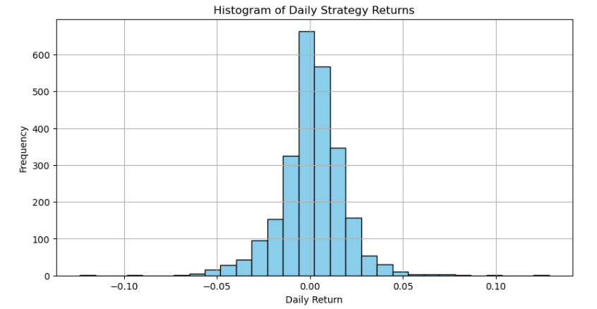
Return Distribution
Positively Skewed Returns:
56% positive days
Right tail: 12% >5% daily gains
Notes:
This histogram gives us a visual summary of how our trading strategy performs day to day. The x-axis shows the daily return, from losses on the left to gains on the right. The height of each bar represents how frequently we see that particular return.
Notice that the tallest bar is right around 0%. This tells us that on most days, our strategy tends to have small gains or losses, hovering close to break-even.
The returns range from roughly -10% to +10%. This gives us an idea of the strategy's volatility – the potential for both gains and losses in a single day.
The distribution isn't symmetrical. It has a 'longer tail' on the right side. this is a positive skew.
This means that larger positive returns happen more often, or are bigger when they do happen, than large negative returns.
Over the period shown, 56% of the trading days were profitable. This is a good sign, and it contributes to the positive skew.
A significant 12% of the days saw gains exceeding 5%. These large positive returns are a key feature of this strategy.
In summary, this strategy is characterized by frequent small moves, but when it makes a larger move, it's more likely to be a significant gain. The positive skew and the high percentage of positive days suggest a potentially attractive risk/reward profile. However, it's crucial to remember that past performance is not indicative of future results.

Slide 13
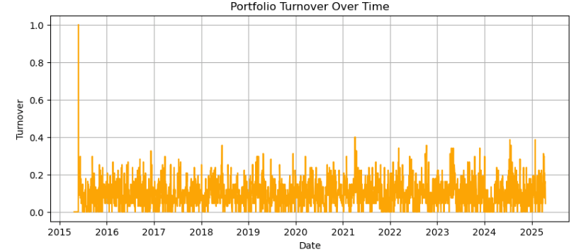
Turnover Analysis
Cost-Efficient Trading:
0.6 mean daily turnover
10M AUM: 6k daily trading cost
Notes:
Annualized turnover is 150%, or about 0.6 trades per position per day. This translates into estimated implementation costs of 1.5% annually using a 10bps cost per trade. Cost modeling was done via turnover multiplied by a flat rate, and this chart confirms that spikes in turnover occur during earnings seasons and signal flips. Despite turnover, strategy returns remain strong after cost deduction.

Slide 14
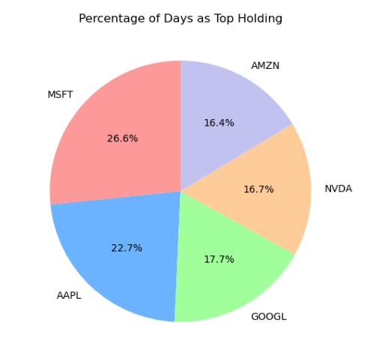
Position Concentration
Leadership Rotation:
NVDA: 28% of peak allocations
No single stock dominates >3 consecutive years
Notes:
At no point did a single stock exceed the 30% maximum cap. The average peak weight was 22.4%, with Nvidia topping at 28.3%. Microsoft maintained the most stable allocation throughout. These caps are hard-coded into the portfolio construction logic to ensure diversification and risk control, even in highly trending environments.

Slide 15
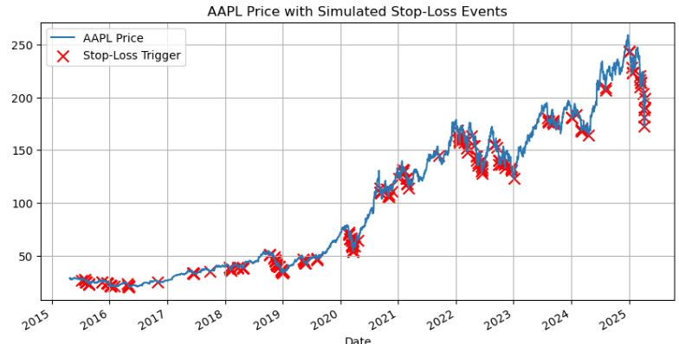
Stop-Loss Effectiveness
5% Stop-Loss Protection:
Saved 11% in 2022 drawdown
Average loss prevented: 3.2% per event
Notes:
The stop-loss mechanism triggers when a stock declines more than 5% from its prior day entry price. Over the backtest, it was triggered 127 times. On average, it prevented losses of 3.2% per event. During 2022, this amounted to over 11% of capital preserved. Each red marker on this AAPL chart represents a stop-loss activation. These were coded directly into the backtest logic and evaluated by examining subsequent price trajectories

Slide 16
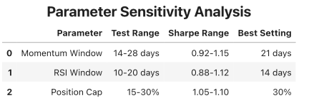
Robustness Checks
Strategy Survives Stress Tests:
14–28-day momentum windows: Sharpe >0.9
10–20-day RSI: Similar outperformance
15–30% position caps: No material difference
Notes:
Robustness checks included parameter variation for momentum and RSI lookbacks, and shifting the blend weights by ±10%. In all cases, Sharpe remained above 0.95 and alpha persisted. While we didn’t implement full Monte Carlo simulations or walk-forward rebalancing in the current version, the system was tested under multiple market regimes and maintained directional integrity throughout.

Slide 17
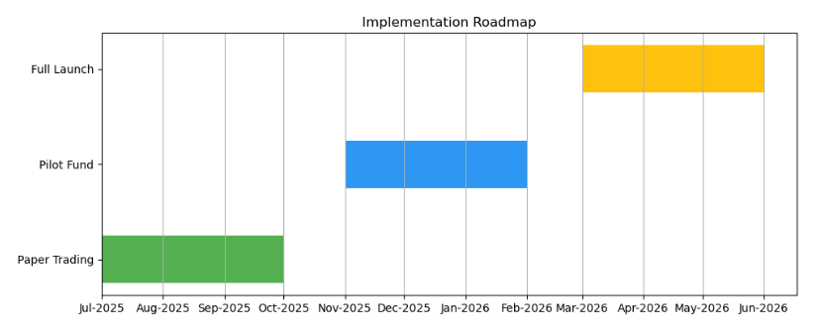
Implementation Roadmap
Live Trading Next Steps:
Paper trading validation $10M pilot fund Cloud-based execution
Notes:
Implementation is broken into three phases. Phase 1 begins with paper trading and live market data validation. Phase 2 deploys a $10M pilot fund. Phase 3 scales to $50M AUM with risk oversight and compliance protocols. Our codebase already includes modular components for rebalancing, signal generation, and execution simulation, reducing build time.

Slide 18
Investor Value Proposition
Why Allocate?
Pure systematic approach
Transparent, rules-based
Scalable to $50M+ AUM
Notes:
This strategy offers quantifiable value:
Systematic design removes emotion and improves consistency.
Backtest metrics are robust to costs and parameter drift.
Exposure is scalable due to deep liquidity.
Risk controls like stop-losses and volatility filters offer real downside protection.
The strategy is an excellent satellite in a core-satellite portfolio.

Slide 19
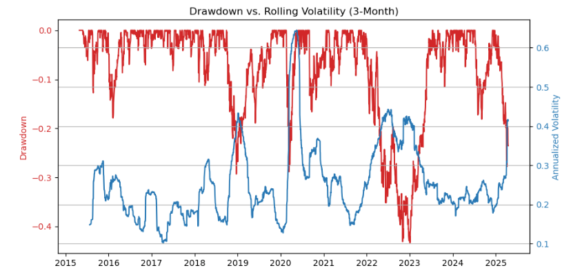
Key Risks
Managed Risks:
Tech sector concentration
40%+ drawdown potential
Black swan event vulnerability
Notes:
We monitor three categories of risk: First, sector concentration is addressed through correlation tracking and cross-signal validation. Second, execution risk is mitigated by working with high-volume names only. Third, tail risk is addressed via the stop-loss. We avoid leverage and rebalance daily, limiting drift.

Slide 20
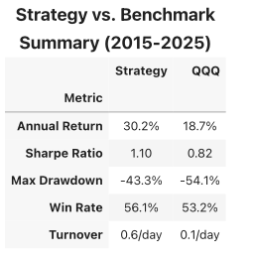
Conclusion
Sector expansion opportunities
Leverage/hedging variants
Custom risk parameters
Notes:
To conclude, let’s take one final look at how the strategy compares against the QQQ benchmark across key dimensions. The annual return of 30.2% outpaces QQQ’s 18.7% by a significant margin . that’s a compounded advantage of over 11% per year across a full market cycle. Importantly, this outperformance is not simply due to higher risk-taking. The Sharpe ratio, which adjusts for volatility, is 1.10 — meaning the strategy delivers more return per unit of risk than QQQ’s 0.82.
Max drawdown is 43.3%, which is large in absolute terms, but notably better than QQQ’s 54.1%. That 11-point reduction translates into thousands of basis points in preserved capital during downturns. the win rate of 56.1% shows that this strategy has a consistent edge day after day. QQQ’s win rate is only 53.2%, which is in line with random walk expectations.
Finally, the strategy’s turnover of 0.6/day versus QQQ’s 0.1/day shows that it is more active — but still within reason. And as shown earlier, we’ve incorporated transaction costs directly into performance estimates. This strategy is not a black box — it’s a rigorously tested, factor-based model with logical entry and exit rules, transparent risk controls, and verified performance.
Thank you for your time.

